Slide 1
OWL and SysML
Where does one end and the other start?

Slide 2
SysML Meta Model Architecture
Layer | Description | Example
meta-metamodel | The infrastructure for a metamodeling architecture. Defines the language for specifying metamodels. | MetaClass, MetaAttribute, MetaOperation
metamodel | An instance of a meta-metamodel. Defines the language for specifying a model. | Class, Attribute, Operation, Component
model | An instance of a metamodel. Defines a language to describe an information domain. | HSUV, OffRoadWheel, DieselMotor XYZ are Names of <<Block>>s
user (run-time) objects (user data) | An instance of a model. Defines a specific information domain. | Joe’s HSUV, Wheel SerNo 123, DieselMotor XYZ SerNo 456
Customization for Specific Domains | Stereotypes extend existing SysML language concepts with additional properties and constraints. | <<Car>>, <<Wheel>>, <<Engine>> are specializations of <<Block>>
Notes:
The meta-metamodeling layer forms the foundation for the metamodeling architecture. The primary responsibility of this layer is to define the language for specifying a metamodel. A meta-metamodel defines a model at a higher level of abstraction than a metamodel, and is typically more compact than the metamodel that it describes. A meta-metamodel can define multiple metamodels, and there can be multiple meta-metamodels associated with each metamodel.( 1 If there is not an explicit meta-metamodel, there is an implicit meta-metamodel associated with every
metamodel). While it is generally desirable that related metamodels and meta-metamodels share common design philosophies and constructs, this is not a strict rule. Each layer needs to maintain its own design integrity. Examples of meta-metaobjects in the meta-metamodeling layer are: MetaClass, MetaAttribute, and MetaOperation.
A metamodel is an instance of a meta-metamodel. The primary responsibility of the metamodel
layer is to define a language for specifying models. Metamodels are typically more elaborate than
the meta-metamodels that describe them, especially when they define dynamic semantics.
Examples of metaobjects in the metamodeling layer are: Class, Attribute, Operation, and
Component.
A model is an instance of a metamodel. The primary responsibility of the model layer is to define a
language that describes an information domain. Examples of objects in the modeling layer are:
StockShare, askPrice, sellLimitOrder, and StockQuoteServer.
User objects (a.k.a. user data) are an instance of a model. The primary responsibility of the user
objects layer is to describe a specific information domain. Examples of objects in the user objects

Slide 3
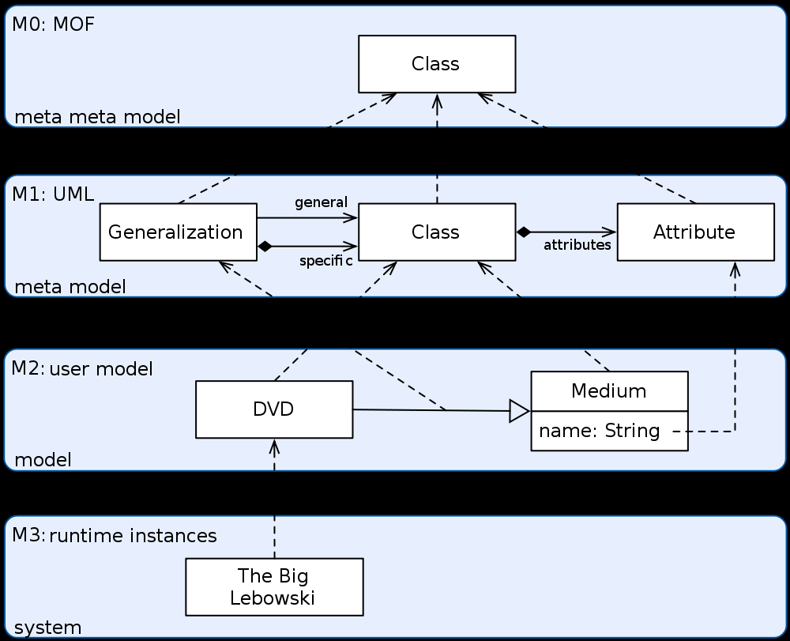
SysML Meta Model hierarchy

Slide 4
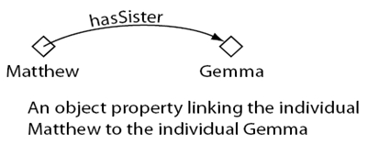
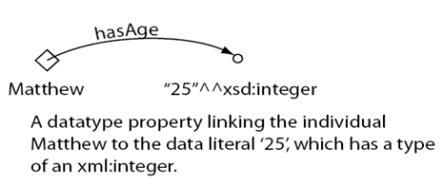
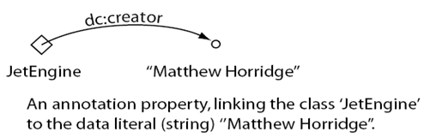
OWL Architecture
Element | Description | Example
Class | Sets that contain Individuals. Classes may be organized into a superclass-subclass hierarchy, which is also known as a taxonomy. | Person, Country, Pet
Object Property | link object to object; represent relationships between two objects. Properties are binary relations on Individuals
Data Property | link object to XML Schema datatype or rdf:literal
Instance, Individual | Individuals are also known as instances. Individuals can be referred to as being ‘instances of classes’. | Matthew, England, Fluffy

Slide 5
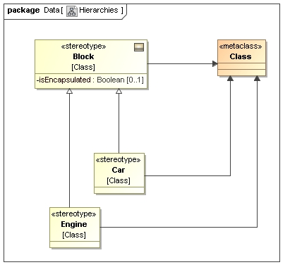
SysML Stereotype vs. Generalization 1/2

Slide 6
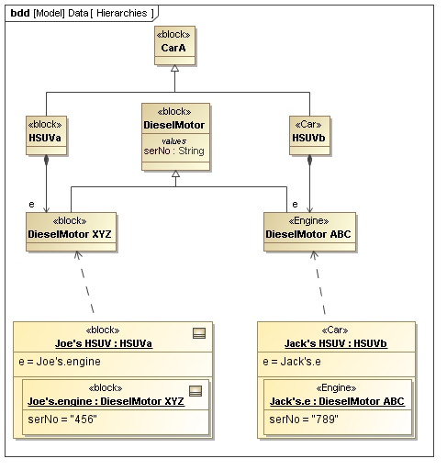
SysML Stereotype vs. Generalization 2/2

Slide 7
Mapping OWL to SysML Generalization??
OWL | SysML | Notes
Class CarA | <<block>> CarA
Class HSUVa | <<block>> HSUVa
Class DieselMotor XYZ | <<block>> DieselMotor XYZ
Object Property hasEngine | Composition with role e
Individual Joe’s HSUV | InstanceSpecification Joe’s HSUV
Data Property serNo | ValueProperty serNo

Slide 8
Mapping OWL to SysML Customization??
OWL | SysML | Notes
Class CarA | <<block>> CarA
Class Car | stereotype <<car>>
Class Engine | Stereotype <<engine>>
Class HSUVb | <<car>> HSUVb
Class DieselMotor XYZ | <<engine>> DieselMotor ABC
Object Property hasEngine | Composition with role e
Individual Jack’s HSUV | InstanceSpecification Jack’s HSUV

Slide 9
OWL Car Ontology
TBD

Slide 10
SysML Stereotypes, etc
Criteria when something is a SysML <<stereotype>> or a Model Element?
  Is a Motor a <<block>> Motor or a <<motor>>
Every Model Element shall be stereotyped according to the domain specific ontology
Criteria when a OWL class is mapped to a SysML <<stereotype>> or a Model Element?
When is a OWL object property a composition or reference association?
Does it make a difference if the intention of the SysML model is to model one particular system (which exists only once) or a product line (where several real-world objects exist)?

Slide 11
Ontologies without OWL
Do you need OWL to make an Ontology?
Use UML Class diagrams to express terms and relationships
Concept of Ontologies is more important than OWL

